Slide 1
Final Presentation
Course Details :
Student Profile :
Course Code: CSE-105
Course Title: Structured Programming
Section : 05
Faculty Name : Md. Shamsujjoha
Name : AL MUTTAKIN
Student ID : 2013-2-60-005

Slide 2
Presentation Topic
Solution of two problems using “Problem Solving Methodology “

Slide 3
Problem Solving Methodology :
Process of solving a problem step by step.
There are 6 different steps.
1. A clear statement of the problem.
2. Description of input , output formation.
3. A handmade solution with Example.
4. Algorithm Development.
5. Writing the C code.
6. Testing the solution with variety of data

Slide 4
Problem : 1
The 3n+1 problem
UVA problem no : 100

Slide 5
Statement:
Consider the following algorithm:
1. input n
2. print n
3. if n = 1 then STOP
4. if n is odd then n = 3n+1
5. else n = n/2
6. GOTO 2

Slide 6
Statement:
The algorithm described before will terminate when
n = 1 for any integral input value. Despite the simplicity of the algorithm, it is unknown whether this conjecture is true. It has been verified, however, for all integers n such that
0 < n < 1,000,000 (and, in fact, for many more numbers than this.)
Given an input n, it is possible to determine the number of numbers printed (including the 1). For a given n this is called the cycle-length of n.
The problem is for any two numbers i and j you are to determine the maximum cycle length over all numbers between i and j.

Slide 7
Standard Input Output formation :
The Input :
The input will consist of a series of pairs of integers i and j, one pair of integers per line. All integers will be less than 1,000,000 and greater than 0. You should process all pairs of integers and for each pair determine the maximum cycle length over all integers between and including i and j. You can assume that no operation overflows a 32-bit integer.
The Output :
For each pair of input integers i and j you should output i, j, and the maximum cycle length for integers between and including i and j. These three numbers should be separated by at least one space with all three numbers on one line and with one line of output for each line of input. The integers i and j must appear in the output in the same order in which they appeared in the input and should be followed by the maximum cycle length (on the same line).

Slide 8
Example :
For the input n = 5, the following steps take place.
1. n=3*5+1=16 [as n is odd]
2. n=16/2=8 [as n is even]
3. n=8/2=4 [as n is even]
4. n=4/2=2 [as n is even]
5. n=2/2=1 [as n is even]
Eventually, for n=5 , cycle length is 6.
Similarly for n=3, the steps are 3,10,5,16,8,4,2,1. So cycle length is 8.
for n=4, the steps are 4,2,1. So cycle length is 3.
Between 3 and 5 the maximum cycle length is 8.So taking 3 and 5 as input the output will be 3 5 8.

Slide 9
Start
Temp1=num1
Temp2=num2
Maxc=0
Temp1++
Swap(temp1,temp2)
T
F
Temp1>temp2
T
Maxc=count
F
Count>maxc
F
F
Temp1<=temp2
T
F
Temp>1
Temp%2==1
temp/=2
T
Temp=temp1
Count=1
T
Temp=3*temp+1
Count++
Output : num1,num2,maxc
End

Slide 10
C code :
#include<stdio.h>
int main()
{
int num1, num2, temp1, temp2, temp, count, maxC;
while(scanf("%d%d“ ,&num1 ,&num2) == 2)
{
temp1 = num1; temp2 = num2; maxC = 0;
if(temp1 > temp2) {temp = temp1; temp1 = temp2; temp2 = temp;}
while(temp1 <= temp2)
{
temp = temp1; count = 1;
while(temp > 1)
{
if(temp % 2 == 1) {temp = (3 * temp) + 1;}
else {temp /= 2;} count++;
}
if(count > maxC) {maxC = count;} temp1++;
}
printf("%d %d %d\n",num1,num2,maxC);
}
return 0;
}

Slide 11
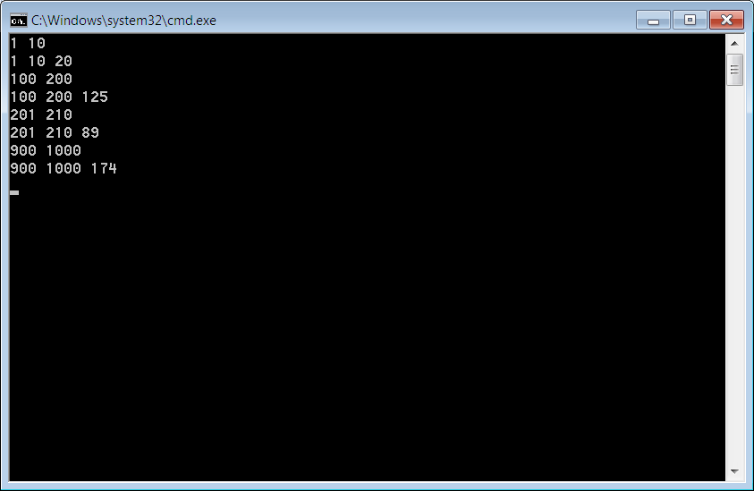
Execution :
Sample Input :
1 10
100 200
201 210
900 1000
Sample Output :
1 10 20
100 200 125
201 210 89
900 1000 174

Slide 12
Problem : 2
The Snail
UVA problem no : 573

Slide 13
Statement:
A snail is at the bottom of a 6-foot well and wants to climb to the top. The snail can climb 3 feet while the sun is up, but slides down 1 foot at night while sleeping. The snail has a fatigue factor of 10%, which means that on each successive day the snail climbs 10% 3 = 0.3 feet less than it did the previous day. (The distance lost to fatigue is always 10% of the first day's climbing distance.) On what day does the snail leave the well
Your job is to solve this problem in general. Depending on the parameters of the problem, the snail will eventually either leave the well or slide back to the bottom of the well. (In other words, the snail's height will exceed the height of the well or become negative.) You must find out which happens first and on what day.

Slide 14
Standard Input Output formation :
The Input :
The input file contains one or more test cases, each on a line by itself. Each line contains four integers H, U, D, and F, separated by a single space. If H = 0 it signals the end of the input; otherwise, all four numbers will be between 1 and 100, inclusive. H is the height of the well in feet, U is the distance in feet that the snail can climb during the day, D is the distance in feet that the snail slides down during the night, and F is the fatigue factor expressed as a percentage. The snail never climbs a negative distance. If the fatigue factor drops the snail's climbing distance below zero, the snail does not climb at all that day. Regardless of how far the snail climbed, it always slides D feet at night.
The Output :
For each test case, output a line indicating whether the snail succeeded (left the well) or failed (slid back to the bottom) and on what day. Format the output exactly as shown in the example.

Slide 15
Example :
A snail is at the bottom of a 6-foot well and wants to climb to the top. The snail can climb 3 feet while the sun is up, but slides down 1 foot at night while sleeping. The snail has a fatigue factor of 10%
As you can see from the following table, the snail leaves the well during the third day.
Day | Initial Height | Distance Climbed | Height After Climbing | Height After Sliding
1 | 0' | 3' | 3' | 2'
2 | 2' | 2.7' | 4.7' | 3.7'
3 | 3.7' | 2.4' | 6.1' | -

Slide 16
START
F
H>0
T
u=U,s=D,
ftg=f=i=0
u=u-ftg
F
T
c=i
u>0
c=i-u
f=c-s
i=f
Ftg=(U*F)%100
F
F
T
f<0
c>h
Printf()
T
END
Printf()

Slide 17
C code :
#include<stdio.h>
int main()
{
int H,U,D,F,d; float ftg,i,f,u,s,c;
while(scanf("%d%d%d%d",&H,&U,&D,&F) && H>0)
{
u=(float)U;
s=(float)D;
ftg=f=i=0.0;
for(d=1;;d++)
{
u=u-ftg;
if(u>=0) { c=i+u; }
else { c=i; }
f=c-s;
i=f;
ftg=(float)(U*F)/100;
if(c>H) {
printf("success on day %d\n",d);
break; }
else if(f<0){
printf("failure on day %d\n",d);
break; }
}
}
return 0;
}

Slide 18
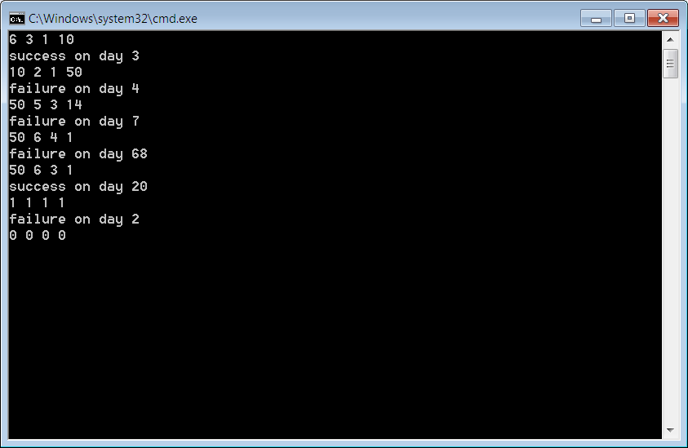
Execution :
Sample Input :
6 3 1 10
10 2 1 50
50 5 3 14
50 6 4 1
50 6 3 1
1 1 1 1
0 0 0 0
Sample Output :
success on day 3
failure on day 4
failure on day 7
failure on day 68
success on day 20
failure on day 2

Slide 19
Thank You

